Slide 1
HEART DISEASE PREDICTION
TSP- AI ML Fundamentals (Capstone Project)
Presented By:
LINGESH S M – au810021214018
Guided By: Ramar Bose Sr. AI Master Trainer

Slide 2
OUTLINE
Problem Statement
Proposed System/Solution
Algorithm & Deployment
GitHub Link
Project Demo(photos / videos)
Conclusion
Future Scope
References

Slide 3
Problem Statement
The goal of this study is to estimate the total risk of heart disease using Logistic Regression and Machine Learning. According to the World Health Organization (WHO), heart attacks account for about four out of every five CVD-related deaths. Identifying those at risk of CVD is critical for implementing preventative strategies and giving timely therapies.

Slide 4
Proposed Solution
The suggested Logistic Regression in Google Collab with Heart Disease Prediction includes data processing, feature selection, and model construction. Using the Logistic Regression model of MI, it is possible to assess an individual's risk of developing cardiovascular disease. This model can help healthcare practitioners identify high-risk patients and implement targeted therapies and lifestyle changes to reduce the risk of CVD-related consequences.

Slide 5
Algorithm & Deployment
Data Preprocessing: The dataset undergoes preprocessing steps such as handling missing values, encoding categorical variables, and scaling numerical features.
Feature Selection: Relevant features are selected based on their significance in predicting CVD risk, using techniques such as correlation analysis and feature importance ranking.
Model Development: A Logistic Regression model is trained using the preprocessed dataset. The model learns to classify individuals into two classes: those at risk of developing CVD and those not at risk.

Slide 6
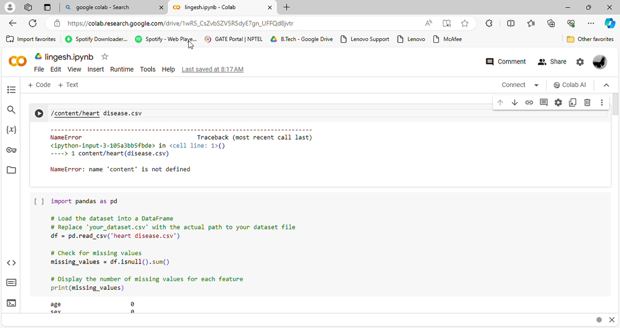
Project Demo(Recorded Video)

Slide 7
GitHub Link
https://github.com/smlingesh26022004/Heart-disease-Prediction-NM

Slide 8
Conclusion
The application of Logistic Regression to predict heart disease risk provides useful insights into identifying those who are more likely to develop cardiovascular disease (CVD) and maybe avoid negative health outcomes. Logistic Regression is used to successfully model the probability of CVD occurrence based on numerous risk variables, allowing for early intervention and focused healthcare interventions. The findings highlight the importance of proactive healthcare activities, such as lifestyle adjustments, regular screenings, and individualized therapies, to reduce CVD risk factors and improve patient outcomes.

Slide 9
Future Scope
The future of Logistic Regression-based heart disease prediction appears promising. When additional risk factors and powerful machine learning approaches are combined, advanced prediction models are likely to develop, resulting in better accuracy and reliability in identifying people at risk of cardiovascular disease (CVD). Furthermore, the concept of customized medicine is set to change heart disease management.

Slide 10
References
Project Github link, Ramar Bose , 2024
Project video recorded link (youtube/github), Ramar Bose , 2024
Project PPT & Report github link, Ramar Bose , 2024

Slide 11
THANK YOU

